Slide 1
High Volume Automated Testing in Security Testing
It’s a numbers game.
Mark Fioravanti
WTST-2013, January 25th, 2013

Slide 2
Agenda
Introduction
High Volume Automated Testing (HiVAT) in Security Testing
HiVAT in Compliance Testing
HiVAT in Penetration Testing
Web Application Penetration Testing
Questions

Slide 3
Who?
Mark Fioravanti
Student
Computer Science PhD Student at FloridaTech
Work
Previously: Security Architect at the Department of Homeland Security’s (DHS) Science and Technology Directorate (S&T), Missing Link Security (contractor for the Federal Bureau of Investigation), Boeing, Honeywell
Certifications
CISSP, GCIA, GCIH, GCWN, GCFA, GWAPT, GPEN, GREM
SANS Mentor
Ability to teach GCIH, GWAPT, GPEN, or GREM

Slide 4
HiVAT in Security Testing
High Volume Automated Testing (HiVAT) is a necessary and essential component of Security Testing
Security is inherently asymmetrical in nature;
An attacker potentially only needs exploit a single vulnerability while the defender needs to mitigate all of the vulnerabilities.
Identifying vulnerabilities to help mitigate them before the attacker can exploit them is one goal of security testing
HiVAT techniques are actively being employed

Slide 5
HiVAT in Security Testing (2)
HiVAT manifests itself in security testing in several ways
Compliance and Auditing
Certification Testing
Vulnerability and System Configuration Enumeration
Penetration Testing
Adopting an adversarial approach and attempting to exploit vulnerabilities
Exploit Research
Common techniques such as fuzzing and others
Will not be covered in this presentation

Slide 6
HiVAT in Compliance
Information Objective in Compliance
Determine if a System is in compliance with the security standards of an organization
Compliance attempts to evaluate the security of a system based on a specific standard
Within the context of Compliance Testing, HiVAT is not a run until failure is encountered test.
The standard acts as the Oracle and deviations are recorded as Non-Compliant
Notes:
Compliance Testing is most similar to Specification-based Testing.
Common Standards include
Federal Information Security Management Act (FISMA) and NIST’s Special Publication 800-53, Recommended Security Controls for Federal Information Systems and Organizations
Payment Card Industry – Digital Security Standard (PCI-DSS)
Health Insurance Portability and Accountability Act’s (HIPAA) Security Rule
Unlike some types of HiVAT testing, Compliance Testing is not a run until failure. The Standard provides as Oracle to assist in determining if the configuration/settings of a system are correct. Deviations from the Oracle are usually recorded as being Non-Compliant.

Slide 7
HiVAT in Compliance (2)
Interviews and Documentation Reviews aside, a large portion of compliance requires:
Network Scanning to determine which services are available
System Configuration auditing to determine if the individual security settings are compliant with organizational policy
The amount of scanning is determined by the number of hosts, the number of ports, and the types of services being provided
Configuration auditing (i.e., a credentialed scan) attempts to help by inspecting the system’s configuration

Slide 8
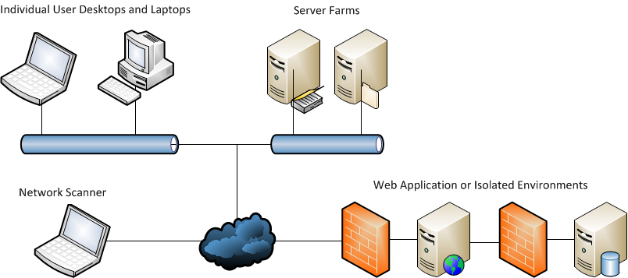
HiVAT in Compliance (3)
It is common to need to perform Compliance testing on dozens to thousands of devices.
Each device can require hundreds to thousands of tests
Notes:
The 2nd High Volume Automated Test aspect of Compliance is that:
There are hundreds two thousands of configuration settings that are checked.
There can be dozens to hundreds of thousands of individual hosts that need to be checked.
The properly implemented network isolation can make scanning the configuration of all of these devices difficult. Web Applications are typically segregated into a 3-Tiered (or more) architecture with the Web Tier, Application Tier, and the Data Tier. Typically these are restricted so there are remote management interfaces and isolated connectivity between the tiers. Some enterprises are hesitant to allow remote access to these network segments so local scanners are employed and management of the scanner is handled via the management interfaces.

Slide 9
HiVAT in Compliance (4)
After the scans and the audits have been completed, there is the report
Most compliance activities are concerned with the number of systems out of compliance
The report although the summary of an automated process is not conveniently exportable to a vulnerability management system
Reports are typically PDFs or Microsoft Word documents
Some COTS products will allow integration with other systems
These types of tests really only test for well known vulnerabilities
Ineffective against flaws which are only partially fixed or not widely known

Slide 10
HiVAT in Penetration Testing
Information Objective in Penetration Testing (1)
Determine if the vulnerabilities in a system are exploitable
Basically enumerate the vulnerabilities in a system and determine if they can be exploited by an adversary
Approach pushed by some organizations to satisfy the “Penetration Testing” requirement
Information Objective in Penetration Testing (2)
With a given skill set and resources, how resistant is the system to exploitation by determined adversary
Basically attempts to answer the question, “Can an attacker compromise the system?”
For example, “Can an attacker gain access to the credit cards?”
Highly dependent on the skill level of the penetration tester

Slide 11
HiVAT in PenTesting (2)
The basic process for performing a Penetration Test
Reconnaissance (BBST: Product Research)
Information gathering about a target system
Mapping (BBST: Software Tours)
Determine what resources and relationships
Discovery (BBST: Multiple Techniques)
Identify potential system vulnerabilities
Hostile Data Stream testing is typically used
Exploitation (BBST: Isolate/Maximize during Bug Reporting)
Exploit the vulnerabilities present in the system
Multiple vulnerabilities may need to be combined to exploit a system
HiVAT techniques are used to bypass security controls and aid in exploitation
Notes:
The basic Penetration Testing Process includes four phases: Reconnaissance, Mapping, Discovery, and Exploitation.
The goal of the Reconnaissance phase to learn as much about the system as possible with limited interactions. Aspects can be automated include crawling the internet looking for information related to the application or company involved in the project. The Reconnaissance Phase is similar to the Product Research phase of Software Testing as described in BBST.
The goal of the Mapping Phase is to create an attack surface map of the application. Typically the application is spidered (crawled) and all of the input/output locations and their relationships are discovered. Mapping is similar to a Software Tour as described in BBST.
The goal of the Discovery Phase is based on the Reconnaissance Phase and Mapping Phase; discover potential vulnerabilities and weaknesses in the application. Discovery is similar to Exploratory Testing, Quick Tests, Domain Testing, and Risk-based Testing as described in BBST. The HiVAT techniques include Hostile Data Stream Testing and Input Fuzzing (run until crash).
The goal of the Exploitation Phase is to make use of the vulnerabilities identified in the Discovery Phase. This phase can be quick as in as soon as a vulnerability is exploited, the Tester is back to the Mapping or Discovery Phase in attempting to learn what new resources, information, and/or functionality has been exposed. Exploitation is similar to the Isolate and Maximize aspects of the Bug Reporting process emphasized in BBST.
In quality Penetration Tests, the Tester will combine multiple vulnerabilities in order to achieve their goal. These vulnerabilities individually may not allow an attacker to gain much in obtaining their objecting but chained together the effect and allow for a total compromise.

Slide 12
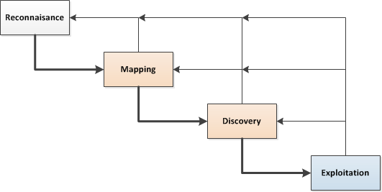
HiVAT in PenTesting (3)
The phases associated with Penetration Tester are not strictly conducted in succession
This should not be treated as a process proceeding in a single direction
When new information is gained, that knowledge should return you to a previous state
Notes:
A Penetration Tester should not strictly move from Reconnaissance, to Mapping, to Discovery, to Exploitation, and then to Report Writing. As they test and learning new information, they should fall back to previous phases where appropriate.

Slide 13
HiVAT in PenTesting (4)
HiVAT appears extensively a Web Application PenTest
Web Applications are every where and custom application tend to have little security built-in
HiVAT is critical to a Web Application PenTest
All pages must be analyzed
All input fields on those pages must be analyzed
All output fields on those pages must be analyzed
Interactions between pages must be analyzed
Multiple languages must be taken into account
JavaScript functions differently between Internet Explorer, Mozilla Firefox, Opera, and Apple Safari
Interactions between the Web Application and any applets (e.g., Java, Flash, etc.)
Notes:
Considering the objective of a quality Penetration Test, HiVAT techniques are essential.
Even with limiting to the scope of a Penetration Test to only include a single Web Application, during the Mapping Phase a database of all of the pages is constructed, on all of those pages a list of all input and output fields, and the relationships between any input and any output field must be identified. Beyond the identification of all of the input and output fields based on simple HTML/HTTP, all of the interactions between and of the client side scripting languages and applets.

Slide 14
HiVAT in Mapping
After Reconnaissance, the Mapping phase occurs in Web Application Penetration Testing
Essentially each page is mapped within a Web Application
Links between pages are recorded
If links are dynamically created then may not be recorded by an automated crawler
Input and output fields are recorded
Automated tools do not effectively handle Asynchronous JavaScript and XML (AJAX) and JavaScript Object Notation (JSON)
Use of applets
Most automated tools do not effectively handle an applet within the context of the application
Pages may need to be visited multiple times based on privileges and group membership

Slide 15
HiVAT in Mapping (2)
Each Pages has
Inputs
What type of content is allowed?
Do allowed inputs change with user permissions or group membership?
Outputs
What results are displayed?
How are the outputs controlled?
What is the source of the data that is displayed?
Automated tools can create internal maps of an application but there is almost no way to share information between automated tools

Slide 16
HiVAT in Discovery
Automated tools are fairly adept at discovering basic flaws in Web Applications with Hostile Data Stream Testing
Good at discovering vulnerabilities such as SQL Injection (SQLi), Cross Site Scripting (XSS), etc.
Automated tools are not as effective in discovering complex flaws
Multiple part attacks where the adversary splits their attack between multiple fields and the applications business logic completes the attack
Largely unable to detect application logic flaws
For example: Can an adversary authorize payment and then add additional items to their shopping cart?

Slide 17
HiVAT in Exploitation
After vulnerabilities have been discovered, the next step is to attempt to exploit the vulnerability
Are there countermeasures that need to bypassed?
Whitelisting vs. Blacklisting
What will this vulnerability allow me to do?
Can it be combined with other vulnerabilities?
There are a number of automated tools which will help with these issues

Slide 18
HiVAT in Exploitation (2)
Developers often include countermeasures to prevent basic attacks. These defenses must be bypassed
Bypassing these filters or defenses require the adversary to modify their attack so it fits within the allowed inputs but still accomplished the adversaries goals
In the case of XSS
<script> is often blocked, <ScRIpt> may be blocked, %3cscript> is less likely to be encoded, etc.
There are over 1 million billion * ways to encode <script>
* Source: Enterprise Security API Project for OWASP Day.
In the case of SQLi
or '1'='1 is typically blocked, or '2'='2 may be blocked, or '1'!='0 is less likely to be blocked
Limits depend on the type of Database Management System

Slide 19
HiVAT in Security
Security Testing requires the use of HiVAT techniques but the current set of tools available are:
Often specialized to accomplish specific tasks, not major issue if they are interoperable with other tools
Reporting of HiVAT results in Security can be problematic as HiVAT could be perceived as just running a large number of individual tests
A tester discovered that there are over a million ways to bypass the input validation routines

Slide 20
Questions?
email: mfioravanti1994 /at/ my /dot/ fit /dot/ edu

