Slide 1
Experiences in Teaching of TDD Course
Nawwar Kabbani, M.Sc.
Cem Kaner, PhD
Florida Institute of Technology

Slide 2
Agenda
Introduction
Objectives
Textbook
Course Material
Topics
Labs, Homework,..
Final Exam
Students Reaction
Common mistakes
Resistance
Summary and Recommendations

Slide 3
Part 1 - Introduction
Personal experience as a student in 2008, TA in 2009…
Class 2008:
Many week students, many dropped
Textbook hell (we’ll come back to it soon)
None completed the final exam
Class 2009:
18 students (incl. 2 grads) – better background
New text book
Better results in the final
I’ll focus on class 2009 in this presentation.

Slide 4
Course objectives
From the syllabus:
Relearn basic programming skills through a lens of writing code that always works ‐‐ move from programming to software engineering.
Adopt industry standard development tools and use them effectively,
Improve your cognitive skills in basic development, especially problem decomposition and technical (programmer to programmer) communication
Learn glass box test techniques
Familiarity with the agile approach to development lifecycles, and gain some experience with agile approaches
Work through exercises, and develop work products, that I think are likely to help you interview for new positions and do well in your first year on the job.

Slide 5
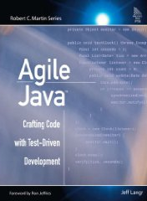
The hell of textbook
2008: Jeff Lagnr’s Agile Java
Cumulative exercises => must follow the order
Late introduction of some basics (e.g. “if” in Ch.5, loops in Ch. 7). So early exercises unnecessarily time-consuming.
Lots of tedious refactoring because of previous problem.
Little guidance on how to refactor.
Examples focused on data management.
Very prescriptive exercises, left almost no room for student’s creativity.

Slide 6
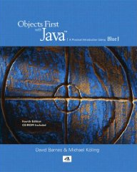
Textbook of 2009
David Barnes & Michael Kolling: Objects First with Java, 4th edition.
Pros:
Objects first!
Different exercises with diverse kinds of problems
Provides some testing ideas
Teaches debugging skills
Cons:
Tightly integrated with BlueJ IDE.
Unit testing is not in the beginning.
Need to adapt the exercises for TDD
Customizing the exercises created bigger gap between the students and the book.

Slide 7
Part 2 - Course contents
Key Topics
In-class Labs
Homework and assignments

Slide 8
Course topics
Basics of unit testing.
Refactoring.
Support tools for software engineering (debugging, source control, coverage monitors, checkstyle).
Unit test design for different types of control structures.
Test design for data structures.
Test design for Boolean expressions.
Structural coverage.
The design of random number generators and the use of RNGs to create test data.
Creation and management of files of test data and files of test oracle data.
System-level testing strategies that test architects would build tools to implement (high-volume test automation based on oracles, or based on diagnostic probes, or based on model-derived stored data).

Slide 9
A little brain-teaser!!
From one of the lectures

Slide 10
Little brain-teaser
Testing a factorial function of an integer (int) n. The function is recursively defined as:
How do you generate your test cases?
What's the smallest number of test cases would you use to achieve “good-enough” testing?

Slide 11
Some interesting test cases
F(0) = 1
F(1) = 1
F(-1) = undefined
F(12) = 479,001,600
F(13) = 6,227,020,800 or overflow?
F(MAX_INT)
F(MIN_INT)Maybe a couple of other valid ones
F(2) = 2
F(3) = 6
Enough?

Slide 12
How knowing code impacts the testing?
From Lagnr’s book:
public int factorial (int n) {
if(n == 0)
return 1;
else
returnn * factorial(n –1);
}

Slide 13
How about this code?
public int factorial (int n) {
if(n == 0) return 1;
elseif (n == 1) return 1;
elseif (n == 2) return 2;
elseif (n == 3) return 6;
elseif (n == 4) return 24;
elseif (n == 5) return 120;
elseif (n == 6) return 720;
elseif (n == 7) return 5040;
elseif (n == 8) return 40320;
elseif (n == 9) return 362880;
elseif (n == 10) return 3628801; // this one looks odd!
elseif (n == 11) return 39916800;
elseif (n == 12) return 479001600;
else return -1; // or throw an exception..
}

Slide 14
Back to “Course Contents”

Slide 15
In-class Labs
Testing basic code structures (e.g. conditionals, loops)
Intro. to refactoring
Problem decomposition, insertion sort as an example.
Debugging
Testing common data structures (e.g. arrays, lists, maps)
Refactoring existing code (two labs).

Slide 16
Homework
5 homeworks
Hello world!
Ticket Machine (conditionals)
Date Arithmetic (loops, Boolean expressions, coverage, oracles)
Files I/O (files, exceptions, oracles)
Parameterized tests (JUnit parameterized tests, data-driven tests, files)
2 assignments.
Random Numbers Generator
Refactoring and code Smells

Slide 17
Final exam
Take home individual project.
Tuned down of the 2008 version.
Grading addressed mainly the following points:
Completeness (how many requirement items were implemented)
Course objectives
Correct using of TDD
Industry standard tools (checkstyle, branch coverage, svn)
Problem decomposition
Technical communication
Glass box techniques
Refactoring
Good test design
Well designed code

Slide 18
Exam results
Student (score%) | SVN Check-ins (commits) | LOC (non-blank) | LOC / Commit
S1 (98) | 83 | 3143 | 37.87
S2 (98) | 52 | 1996 | 38.38
S3 (95) | 50 | 1785 | 35.7
S4 (94) | 116 | 3567 | 30.75
S5 (90) | 61 | 1600 | 26.23
S6 (88) | 28 | 999 | 35.68
S7 (86) | 34 | 774 | 22.76
S8 (81) | 105 | 1660 | 15.81
S9 (80) | 33 | 1080 | 32.73
S10 (79) | 19 | 1429 | 75.21
S11 (52) | 21 | 884 | 42.1
S12 (52) | 21 | 639 | 30.43
S13 (52) | 73 | 415 | 5.68
S14 (30) | 57 | 918 | 16.11
S15 (28) | 18 | 385 | 21.39
S16 (16) | 8 | 489 | 61.13
NB: 2 students didn’t submit the final

Slide 19
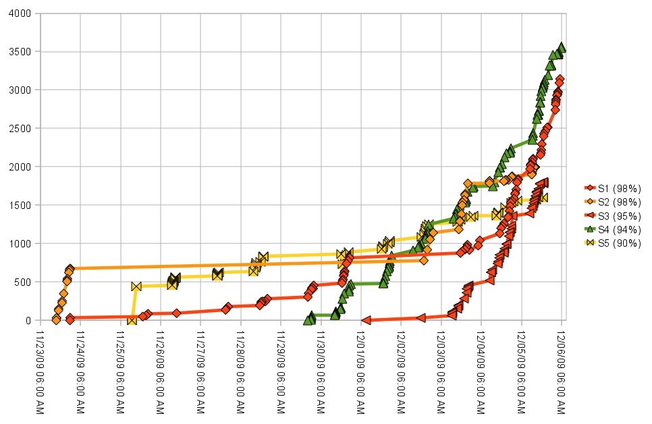
Subversion commits over time – top 5 scores

Slide 20
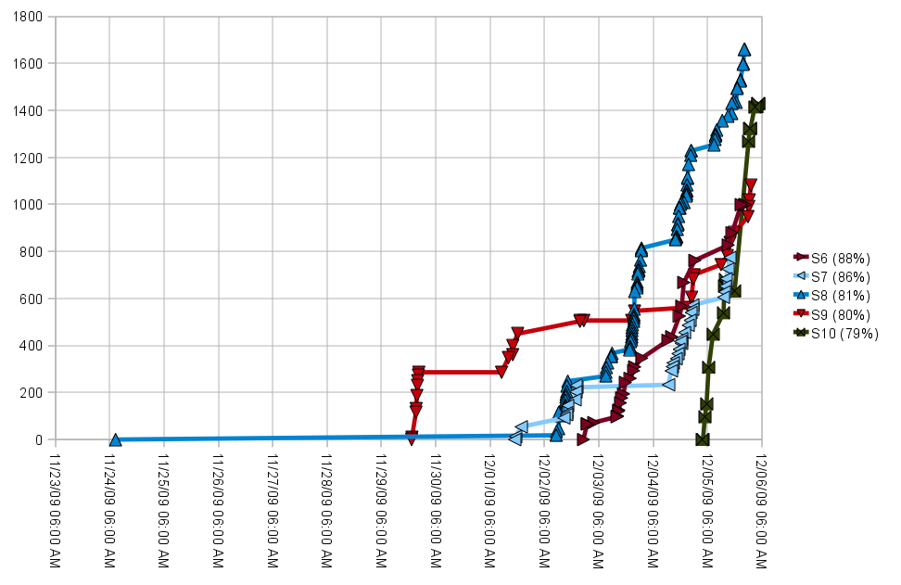
Subversion commits over time – middle scores

Slide 21
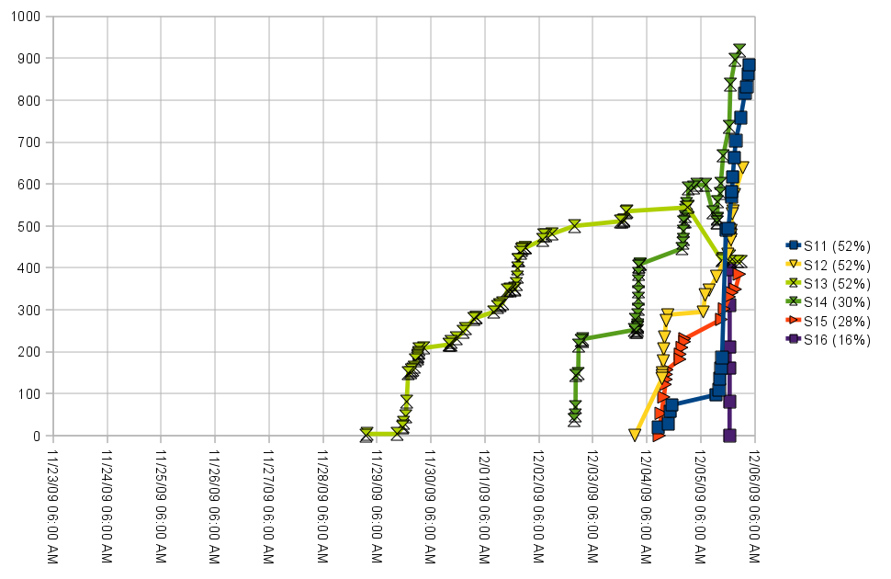
Subversion commits over time – bottom 6 scores

Slide 22
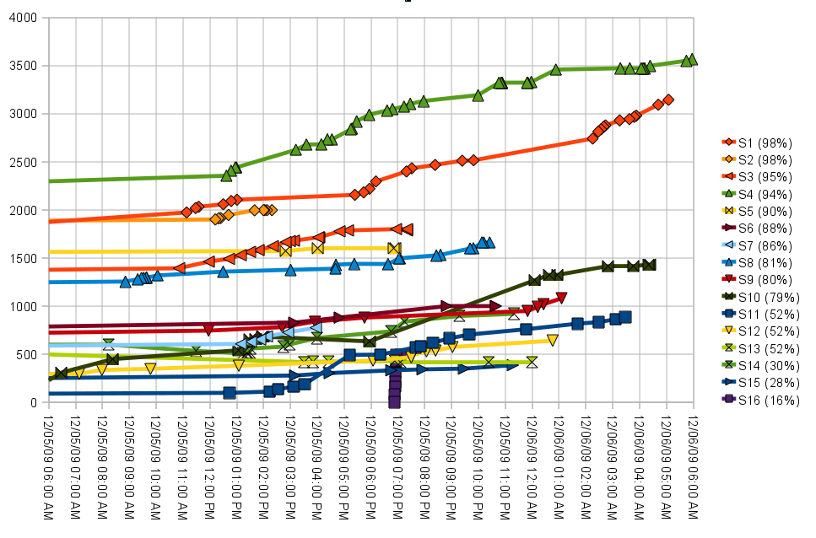
Subversion commits over time – last 24 hours

Slide 23
3 - Student Reaction
- Implementation mistake patterns
- Resistance

Slide 24
Students mistakes
Writing “debug messages” to the standard output instead of depending on unit testing
Testing files I/O
assertTrue(file.Delete()); !!!!
Dependency on the order of tests
Avoiding magic numbers by using magic constants! (static final int THIRTY_ONE=31)

Slide 25
Students mistakes, cont.
Exceptions Hiding
public void test() {
try {
foo(“acceptable params”); /* foo is declared with “throws” but is not expected to throw any exception here. */
. . .
} catch (Exeption e) { /* nothing! */ }
}
Exceptions for flow control
public void foo(int x) {
try {
if (x < 0) throw new Exception();
. . .
} catch (Exception e) {
// Do nothing!!!
}
}

Slide 26
Students resistance
Difficulty decomposing tasks
Size of iterations
Writing tests after code
There are symptoms such as tests that never fail!:
public void test() {
try {
foo(“invalid params”); // There must be a ‘fail()’ after this line
}
catch (Exception e) {
assertEquals(“Expected exception message”, e.getMessage());
}
}
Refactoring and Code Smells!!

Slide 27
Finally! Summary and recommendations
The book!
Learning objects (videos)
Quizzes, Excercises, Labs, etc.
Grading supporting tools?

